Slide 1
MACHINE LEARNING GUILD
CLASSIFICATION

Slide 2
MACHINE LEARNING GUILD
AGENDA: WEEK
MON
TUE
WED
THUR
FRI
INTROS, SETUP, & 101
REGRESSION & BOOSTING
CLUSTERING, CLASSIFICATION, DECISION TREES & SVM
TIME SERIES, NEURAL NETWORKS, & NLP
PLOTLY DASH & CAPSTONE PITCHES

Slide 3
MACHINE LEARNING GUILD
AGENDA: TODAY
WED
8:00 AM - 8:30 AM
8:30 AM - 9:15 AM
9:15 AM - 9:30 AM
9:30 AM - 10:30 AM
10:30 AM - 12:30 PM
12:30 PM - 1:30 PM
1:30 PM - 2:00 PM
2:00 PM -3:00 PM
3:00 PM - 4:00 PM
4:00 PM - 5:00 PM
INTRODUCTION TO CLUSTERING TECHNIQUES
K-MEANS
BREAK
OTHER CLUSTERING TECHNIQUES
INDEPENDENT CLUSTERING EXERCISE
LUNCH
INTRODUCTION TO CLASSIFICATION MODELS
LOGISTIC REGRESSION
NAÏVE BAYES
DECISION TREES, RANDOM FOREST, KNN, SVM

Slide 4
CLASSIFICATION
OTHER CLASSIFICATION MODELS
Ensemble Techniques
KNN (K-Nearest Neighbors)
Decision Tree
Gradient Boosting
Naïve Bayes
Support Vector Machine
Random Forest

Slide 5
CLASSIFICATION
CORE OF THE MODELS
What should I think about when learning a new Algorithm?
1) Model Form
Pop quiz! Who can tell me what a model is?

Slide 6
CLASSIFICATION
CORE OF THE MODELS
What should I think about when learning a new Algorithm?
1) Model Form
Pop quiz! Who can tell me what a model is?
2) Loss Function
Pop quiz! Who can tell me what a loss function is?

Slide 7
CLASSIFICATION
CORE OF THE MODELS
What should I think about when learning a new Algorithm?
1) Model Form
Pop quiz! Who can tell me what a model is?
2) Loss Function
Pop quiz! Who can tell me what a loss function is?
3) Optimization Criterion
Pop quiz! Who can tell me what an optimization criterion is?

Slide 8
CLASSIFICATION
CORE OF THE MODELS
What should I think about when learning a new Algorithm?
1) Model Form
Pop quiz! Who can tell me what a model is?
2) Loss Function
Pop quiz! Who can tell me what a loss function is?
3) Optimization Criterion
Pop quiz! Who can tell me what an optimization criterion is?
4) Optimization Routine
Pop quiz! Who can tell me what an optimization routine is?

Slide 9
CLASSIFICATION
CORE OF THE MODELS
What should I think about when learning a new Algorithm?
1) Model Form
Pop quiz! Who can tell me what a model is?
2) Loss Function
Pop quiz! Who can tell me what a loss function is?
3) Optimization Criterion
Pop quiz! Who can tell me what an optimization criterion is?
4) Optimization Routine
Pop quiz! Who can tell me what an optimization routine is?
1) How we calculate our prediction
2) How off was our prediction
1) How off were we on all the data
1) How off were we on all the data

Slide 10
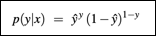
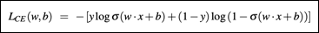
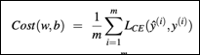
.
CLASSIFICATION
CORE OF THE MODELS
Can you tell me these for logistic regression?
1) Model Form
Sigmoid
2) Loss Function
Binary Cross Entropy
3) Optimization Criterion
Average Log-Likelihood
4) Optimization Routine
Gradient Descent!

Slide 11
CLASSIFICATION
CODING

Slide 12
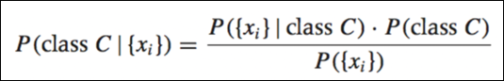
.
CLASSIFICATION
NAÏVE BAYES THEOREM
1) Model Form
Given a frequency table
2) Loss Function
None! (No Parameters to optimize)
3) Optimization Criterion
None!
4) Optimization Routine
None!

Slide 13
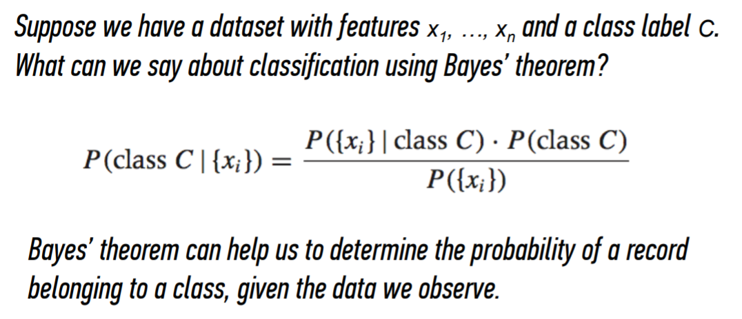
CLASSIFICATION
NAÏVE BAYES THEOREM

Slide 14
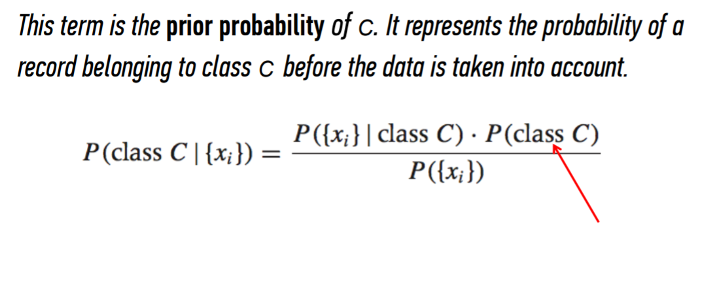
CLASSIFICATION
NAÏVE BAYES THEOREM

Slide 15
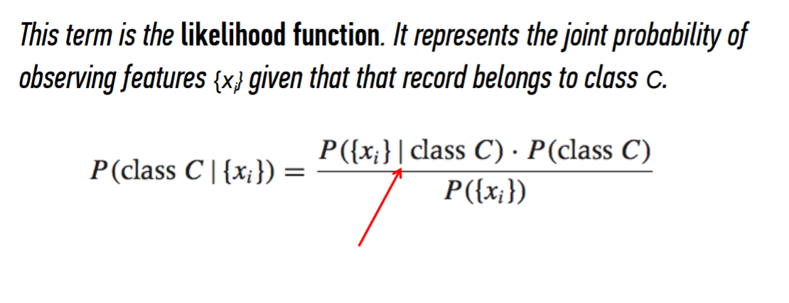
CLASSIFICATION
NAÏVE BAYES THEOREM

Slide 16
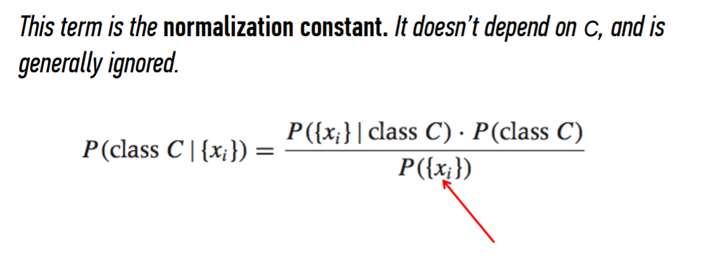
CLASSIFICATION
NAÏVE BAYES THEOREM

Slide 17
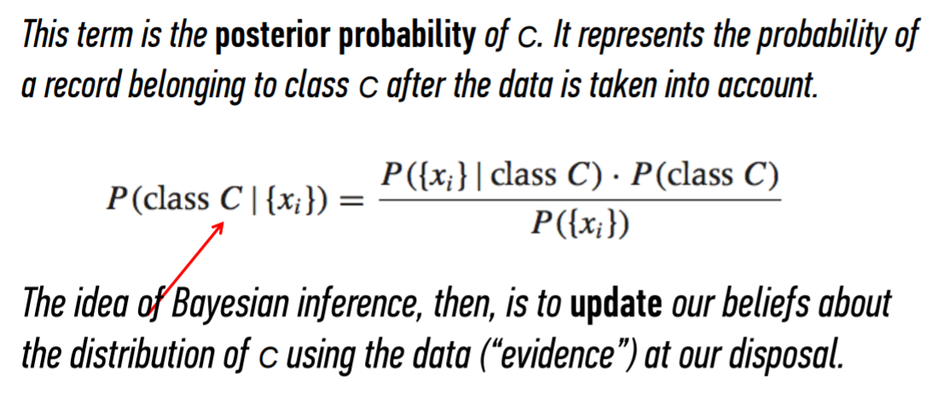
CLASSIFICATION
NAÏVE BAYES THEOREM

Slide 18
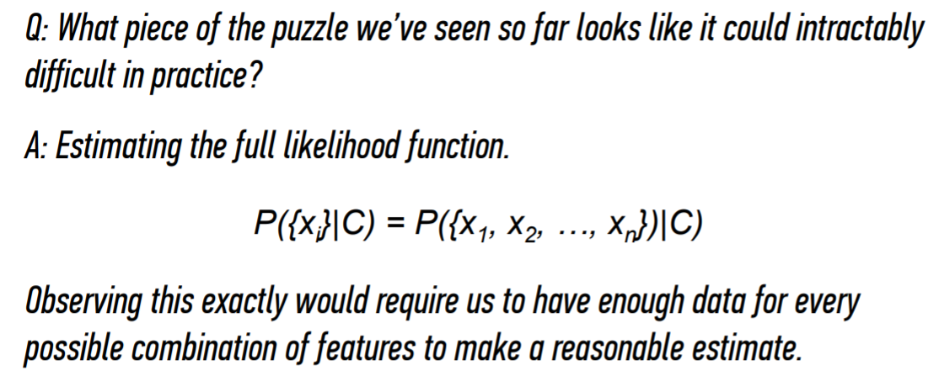
CLASSIFICATION
NAÏVE BAYES THEOREM

Slide 19
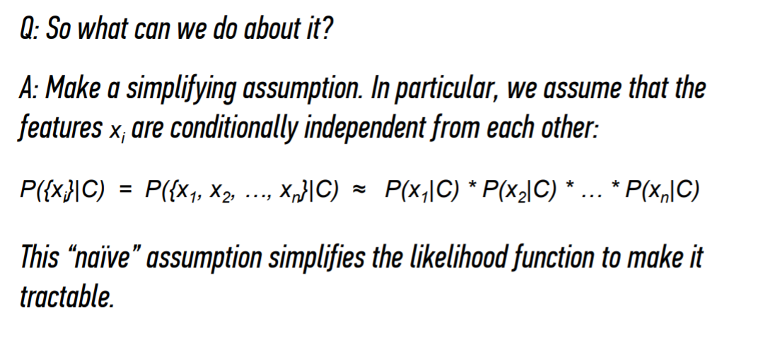
CLASSIFICATION
NAÏVE BAYES THEOREM
Notes:
https://translatingnerd.com/2018/02/08/searching-for-lost-nuclear-bombs-bayes-rule-in-action/

Slide 20
CLASSIFICATION
CODING

Slide 21
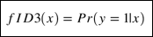
.
CLASSIFICATION
DECISION TREES
1) Model Form
Follow the tree!

Slide 22
.
CLASSIFICATION
DECISION TREES
1) Model Form
Follow the tree!
2) Loss Function
Slightly different given the form of the model

Slide 23
.
CLASSIFICATION
DECISION TREES
1) Model Form
Follow the tree!
2) Loss Function
Slightly different given the form of the model
3) Optimization Criterion
Average Log-Likelihood

Slide 24
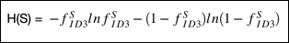
.
CLASSIFICATION
DECISION TREES
1) Model Form
Follow the tree!
2) Loss Function
Slightly different given the form of the model
3) Optimization Criterion
Average Log-Likelihood
4) Optimization Routine
Recursively split the tree based on best current split calculated with Entropy
We have a stopping piece to our recursive split

Slide 25
.
CLASSIFICATION
DECISION TREES
1) Model Form
Follow the tree!
2) Loss Function
Slightly different given the form of the model
3) Optimization Criterion
Average Log-Likelihood
4) Optimization Routine
Recursively split the tree based on best current split calculated with Entropy
We have a stopping piece to our recursive split
Stopping
All data is correctly classified
No features left to split on
Entropy not worth it (we define)
Max depth (we define)

Slide 26
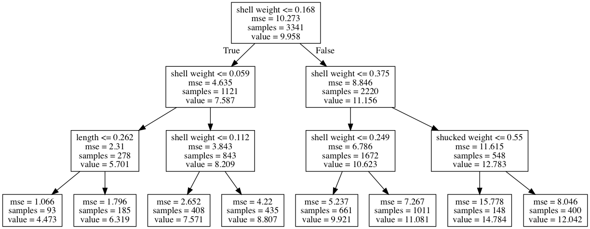
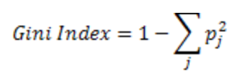
CLASSIFICATION
DECISION TREES
Find the purest split (using gini index)
Find the next purest split
Continue until max depth is reached
Tuning: max_depth, min_sample_leaf

Slide 27
CLASSIFICATION
DECISION TREES
Advantages
Easy to interpret and make for straightforward visualizations.
The internal workings are capable of being observed and thus make it possible to reproduce work.
Can handle both numerical and categorical data.
Perform well on large datasets
Are extremely fast
Disadvantages
Purest split at each step might lead to local maximum not global maximum
Prone to overfitting, leads to high variance from sample to sample

Slide 28
CLASSIFICATION
CODING

Slide 29
.
CLASSIFICATION
KNN
1) Model Form
Class is defined as average class
Distance is our only metric – what is the closest data?

Slide 30
.
CLASSIFICATION
KNN
1) Model Form
Class is defined as average class
Distance is our only metric – what is the closest data?
2) Loss Function
None!

Slide 31
.
CLASSIFICATION
KNN
1) Model Form
Class is defined as average class
Distance is our only metric – what is the closest data?
2) Loss Function
None!
3) Optimization Criterion
None!

Slide 32
.
CLASSIFICATION
KNN
1) Model Form
Class is defined as average class
Distance is our only metric – what is the closest data?
2) Loss Function
None!
3) Optimization Criterion
None!
4) Optimization Routine
None!

Slide 33
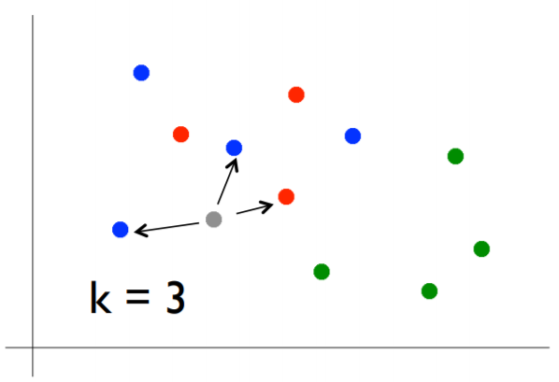
CLASSIFICATION
KNN
Pick a value for k
Find colors of k nearest neighbors
Assign the most common color to the gray dot
Tuning: k_neighbors
Notes:
Use Game of Thrones example!

Slide 34
CLASSIFICATION
KNN
Advantages
Can learn complex topics by local approximation (simple methods)
No assumptions or cost of learning
Disadvantages
Does not handle categorical values well
Can’t be interpreted
Computationally expensive

Slide 35
CLASSIFICATION
CODING

Slide 36
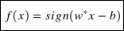
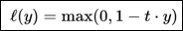
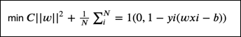
.
CLASSIFICATION
SVM
1) Model Form
What side of the line is our data on
2) Loss Function
Hinge Loss
Where y = form of the decision boundary,linear =
3) Optimization Criterion
Below
4) Optimization Routine
Find the optimal line

Slide 37
CLASSIFICATION
SVM
Define a boundary between blue and red
Draw a line between blue and red separating the data
Use relevant nearby datapoints to minimize the hinge loss
Notes:
Use Game of Thrones example!

Slide 38
CLASSIFICATION
SVM
Define a boundary between blue and red
Draw a line between blue and red separating the data
Use relevant nearby datapoints to minimize the hinge loss
Notes:
Use Game of Thrones example!

Slide 39
CLASSIFICATION
SVM
Define a boundary between blue and red
Draw a line between blue and red separating the data
Use relevant nearby datapoints to minimize the hinge loss
Notes:
Use Game of Thrones example!

Slide 40
CLASSIFICATION
SVM
Previously we looked at linear SVM, but we don’t need to define a linear line
Enter the Kernel trick- SVMs instead of trying to define a polynomial or curve line, could we define a plane in a linear plane in a higher dimension?
Kernel Trick
Notes:
Use Game of Thrones example!

Slide 41
CLASSIFICATION
SVM
Previously we looked at linear SVM, but we don’t need to define a linear line
Enter the Kernel trick- SVMs instead of trying to define a polynomial or curve line, could we define a plane in a linear plane in a higher dimension?
Kernel Trick
Notes:
Use Game of Thrones example!

Slide 42
CLASSIFICATION
SVM
Previously we looked at linear SVM, but we don’t need to define a linear line
Enter the Kernel trick- SVMs instead of trying to define a polynomial or curve line, could we define a plane in a linear plane in a higher dimension?
Kernel Trick
Notes:
Use Game of Thrones example!

Slide 43
CLASSIFICATION
SVM
Previously we looked at linear SVM, but we don’t need to define a linear line
Enter the Kernel trick- SVMs instead of trying to define a polynomial or curve line, could we define a plane in a linear plane in a higher dimension?
Kernel Trick
Notes:
Use Game of Thrones example!

Slide 44
CLASSIFICATION
SVM
Advantages
Can learn non-linearity
Handles high dimensionality
Low chance of over-fitting
Disadvantages
Choosing kernel function
Non-interpretability
Poor vis

Slide 45
CLASSIFICATION
CODING

Slide 46
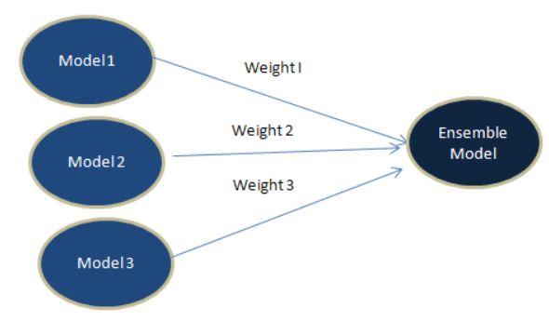
.
Ensembles
Ensemble Modeling
The process of combining multiple outputs from diverse models to produce a single improved output.
As long as the base-models are diverse and independent, the prediction error of an ensemble model decreases in comparison to the input base models.

Slide 47
.
Ensembles
Averaging
The simplest method of ensemble modeling is to average across each individual prediction from the base-models.
Model 1 Prediction = 1
Model 2 Prediction = 1
Ensemble Prediction = 0.66
Model 3 Prediction = 0

Slide 48
.
Ensembles
Weighted Averaging
Not all models are created equal and sometimes the better performing base-models should contribute more to the final outcome. Weighted averaging allows the input models to contribute to the ensemble in proportion to their performance.
Model 1 Prediction = 1
Weight 1
Model 2 Prediction = 1
Weight 2
Ensemble Prediction = 0.8
Advanced Technique: Use an optimization model to determine the best weights for averaging.
Weight 3
Model 3 Prediction = 0

Slide 49
.
Ensembles
Voting
With the voting method, Democracy helps to determine the optimum prediction. The final output is decided by the most common prediction among the individual base-models.
Model 1 Prediction = 1
Model 2 Prediction = 1
Ensemble Prediction = 1
Note: Most commonly used in classification where predictions are discrete values.
Model 3 Prediction = 0

Slide 50
.
Ensembles
Stacking
Base-models are trained on a complete training set. Then the base-model predictions are used as input features to train the stacked-model, which outputs the ensemble prediction.
Model 1 Predictions
Model 2 Predictions
Stacked Model
Ensemble Prediction
Model 3 Predictions

Slide 51
.
Ensembles
Blending
Blending follows the same approach as stacking but only uses predictions from the base-models using a holdout (validation) set as inputs to the ensemble model.
Model 1 Holdout Predictions
Model 2 Holdout Predictions
Blended Model
Ensemble Prediction
Model 3 Holdout Predictions

Slide 52
.
Ensembles
Bagging
Bootstrap Aggregation generates multiple data subsets by sampling from the training data with replacement. This allows each model to be built on a different & random subset of the data and is how a Random Forest works!
Dataset 1
Model 1
Full Dataseet
Dataset 2
Model 2
Combined Prediction
Dataset 3
Model 3

Slide 53
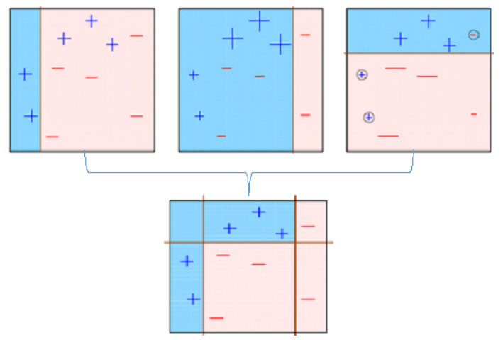
.
Ensembles
Boosting
Boosting is a process where a series of models are trained, with each model after the first built on the residuals from the model before it. In this way each model is built correcting the error from the previous model.
Note: Because boosting models are trained on the residuals of the model before it, it can be prone to overfitting if you are not careful.

Slide 54
.
CLASSIFICATION
RANDOM FOREST
1) Model Form
Majority Vote of Decision Tree
2) Loss Function
Decision Tree
3) Optimization Criterion
Decision Tree
4) Optimization Routine
Decision Tree

Slide 55
.
CLASSIFICATION
GRADIENT BOOSTING
1) Model Form
Majority Vote of Weighted Decision Tree
2) Loss Function
Decision Tree
3) Optimization Criterion
Decision Tree
4) Optimization Routine
Decision Tree

Slide 56
CLASSIFICATION
Q&A

Slide 57
REFERENCES
https://en.wikipedia.org/wiki/K-nearest_neighbors_algorithm
https://web.stanford.edu/~jurafsky/slp3/5.pdf

